Slide 1
Automatic Room Humidifier
DIY Project Team- I
Final Presentation

Slide 2

AUTOMATIC ROOM HUMIDIFIER

Slide 3

IN BRIEF
INTRODUCTION
MOTIVATION
HARDWARE COMPONENTS
SOFTWARE
WORK PLAN
SCHEMATIC
WORK SHARING

Slide 4

Automatic Room Humidifier
A ‘Humidifier’ is a device, primarily an electrical appliance, used to increase humidity (moisture) of a room.
There are many kind of humidifiers such as ultrasonic, evaporative and impeller humidifiers.
In this project we have made a Ultrasonic Humidifier by ourselves and automated it using an Arduino and Humidity Sensor.

Slide 5


MOTIVATION
Due to the increasing rate of climate change, the climate is becoming more and more unpredictable. One effect of this is low humidity during the peak winter and summer months.
The adverse effects of low humidity include chronic dry skin, chapped lips, a scratchy throat, and an itchy nose.
Hence to tackle this problem we are creating this Automatic Room Humidifier.

Slide 6
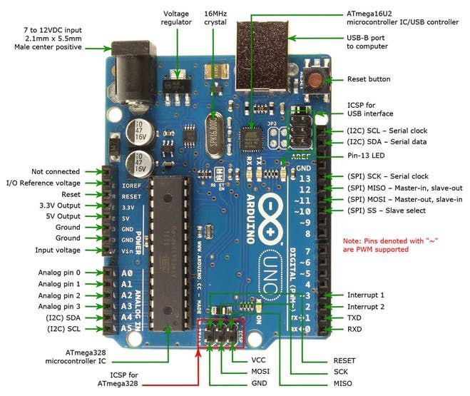
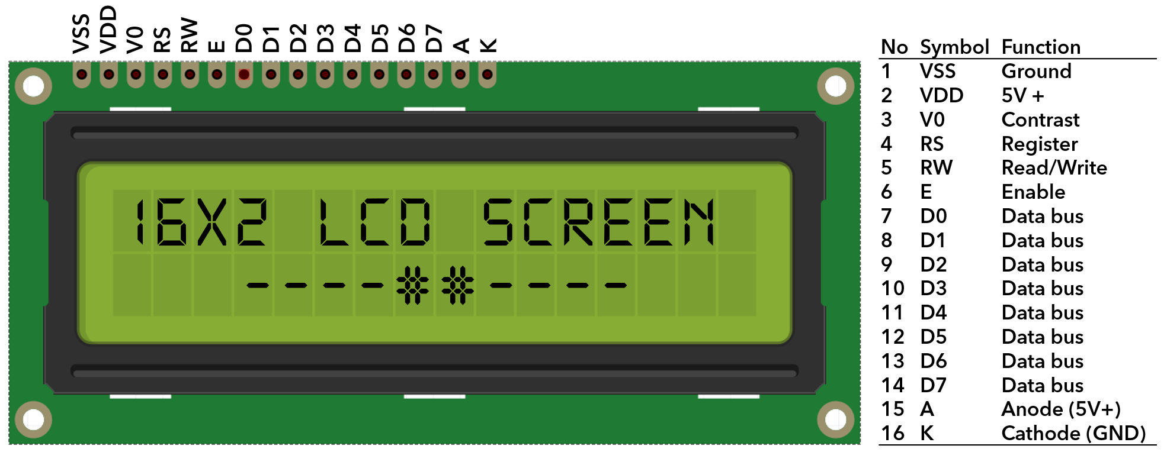
HardWare Components
Arduino
Microcontroller
Controls electronics through inputs & outputs
LCD 16X2 display
2 lines with 16 characters
Each character 5X8 pixel matrix

Slide 7
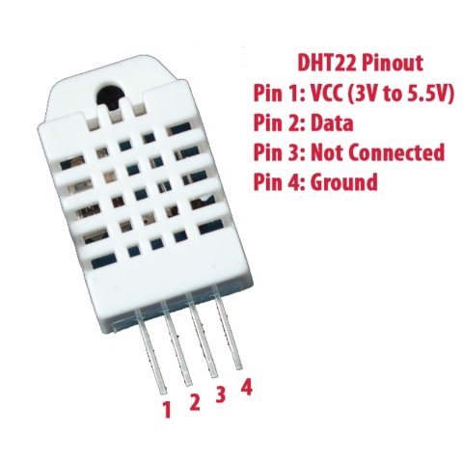
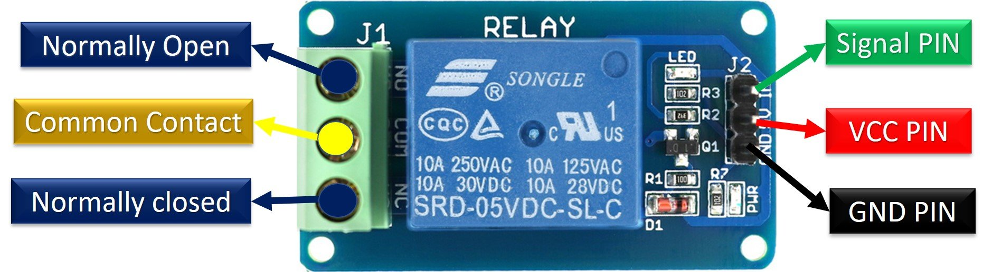
HardWare Components
DHT22 Temperature and Humidity Sensor
Humidity and temperature sensor
Accuracy : 2-5 %
Relay
High Voltage & High Current controller
Operated in Normally Open mode (in this project)
We are using 5V DC relay.

Slide 8
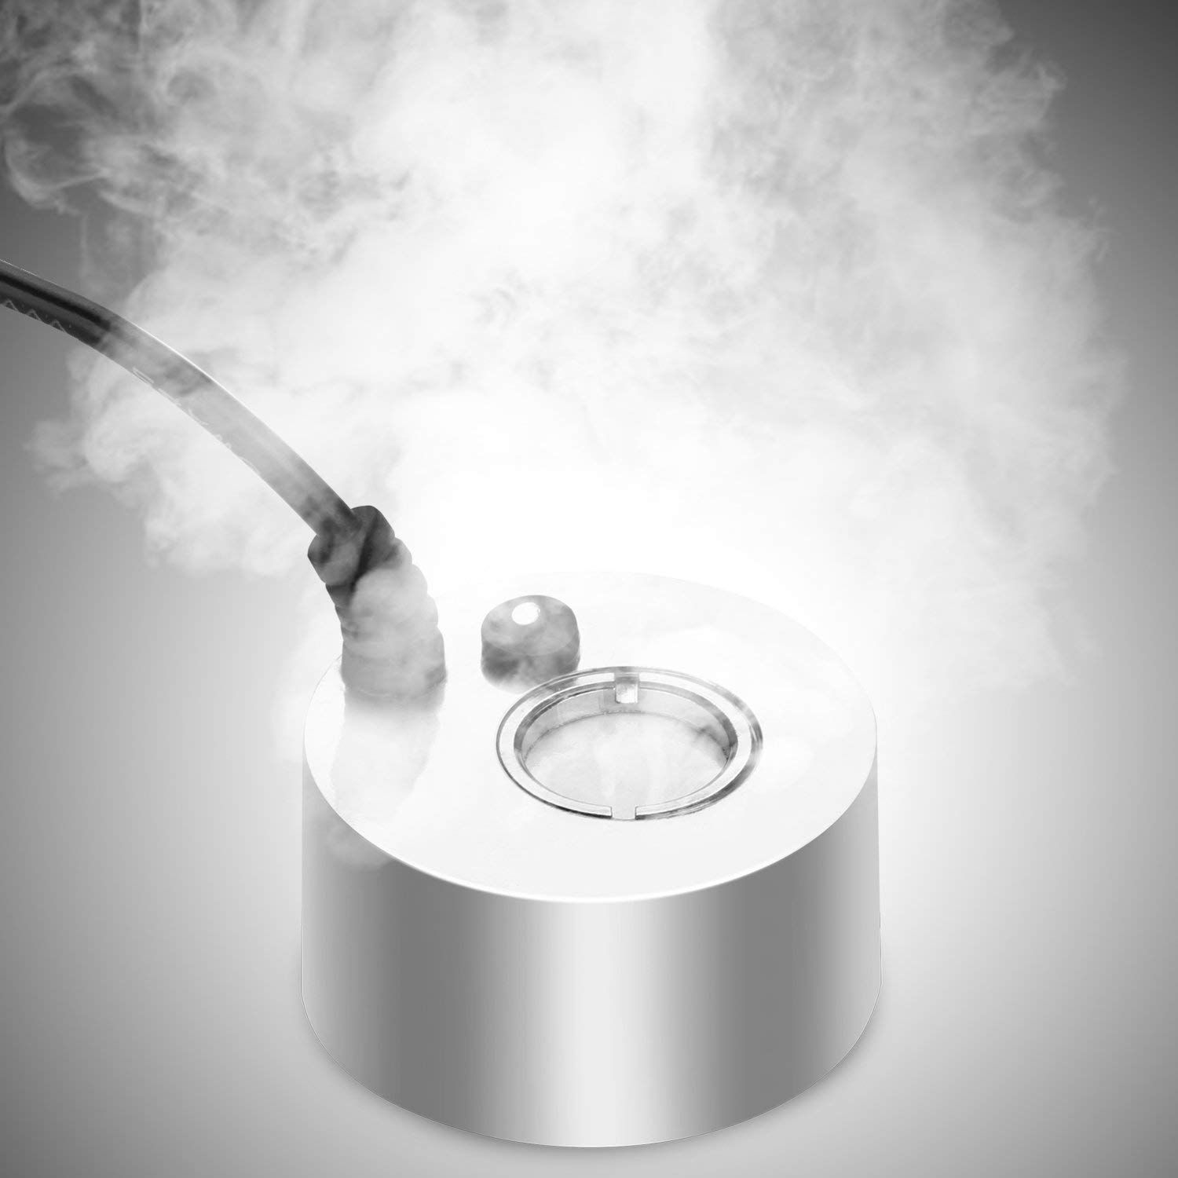
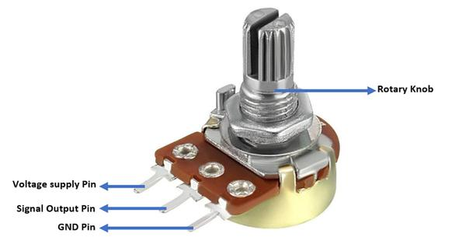
Hardware Components
Mist maker
Ultrasonic mist maker with piezoelectric transducer
24V DC, 1A
Potentiometer
It provides variable resistance
10K Ω (in our project)

Slide 9
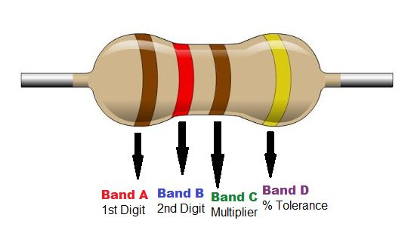
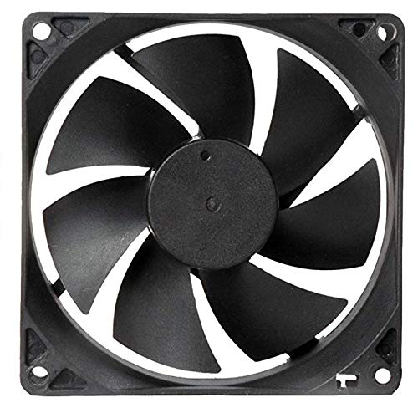
HardWare Components
Resistors
220Ω resistor (in our project)
Fan
12V DC Powered
Rating-12V,1A

Slide 10
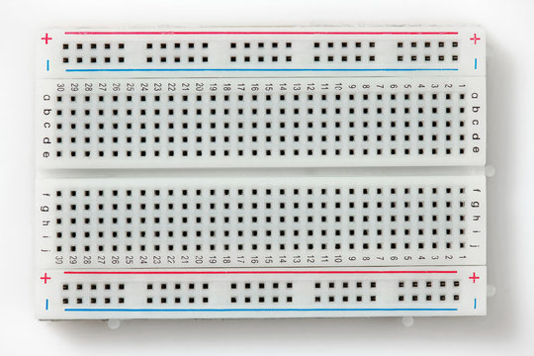
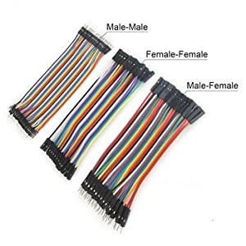
HardWare Components
Bread-Board
Jumper wires

Slide 11
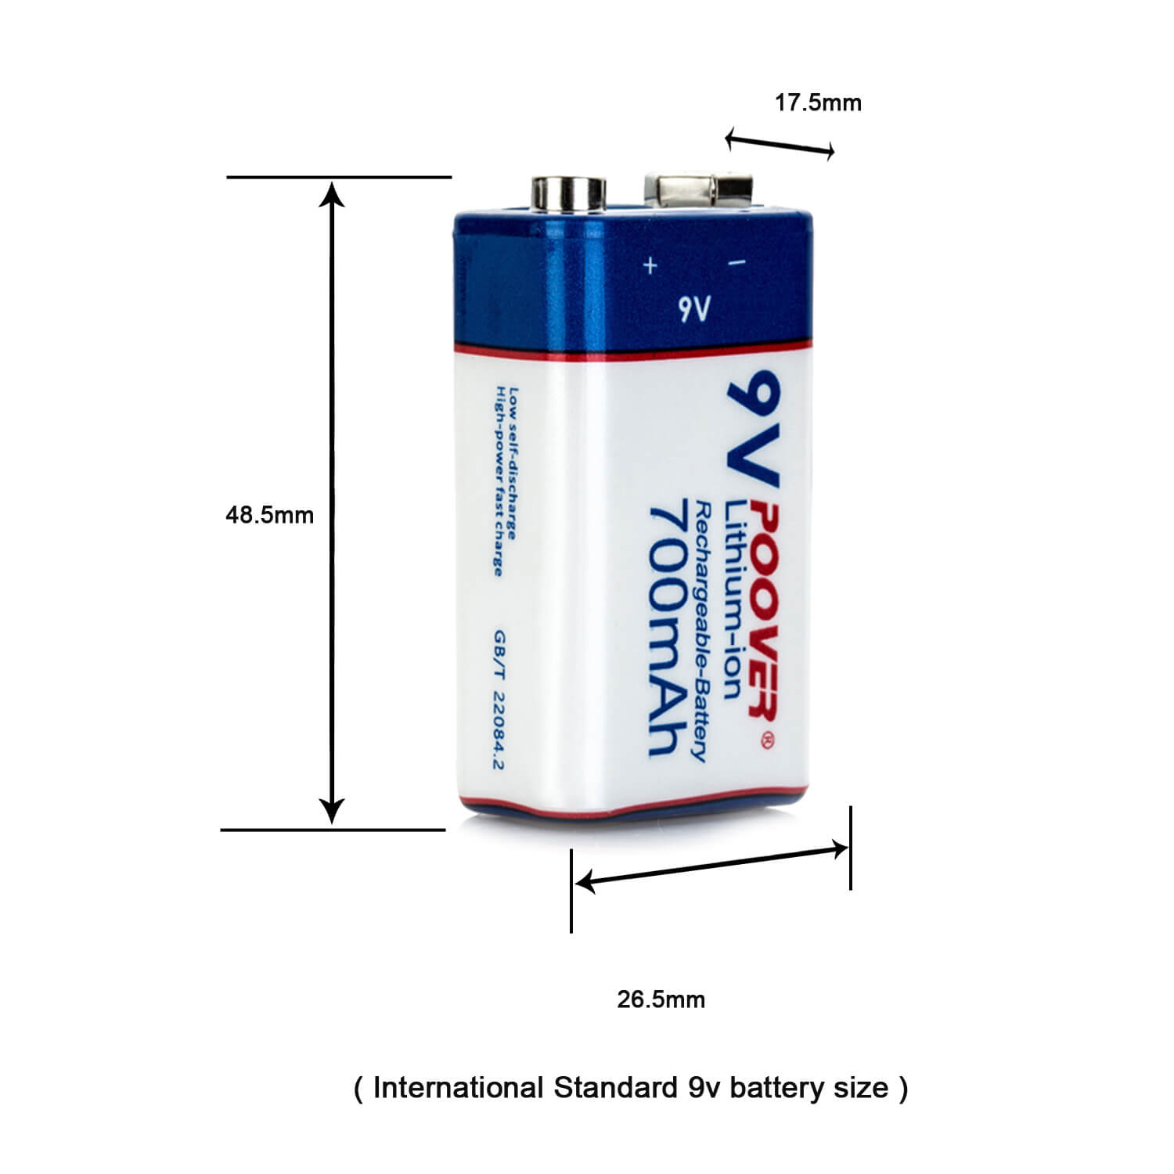
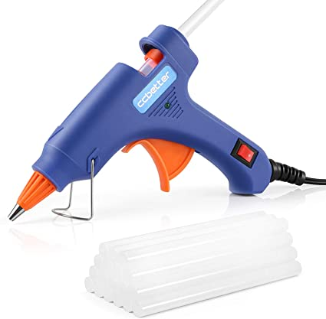
HardWare Components
9V DC Battery
Glue Gun
It is used to melt adhesive and then stick things together using the liquid adhesive.
Rating – 40W, 220-240V

Slide 12
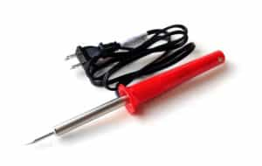
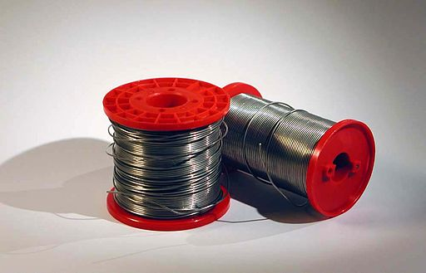
HardWare Components
Soldering Kit
It consists of the following components :
Soldering Iron
Solder Wire
Hand-tool used in soldering which is used to supply heat.
Solder wire is a fusible metal alloy wire used to join metal work pieces.

Slide 13
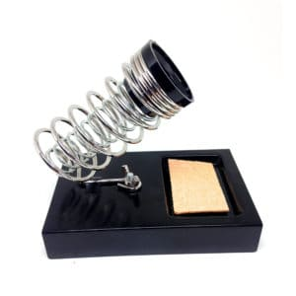

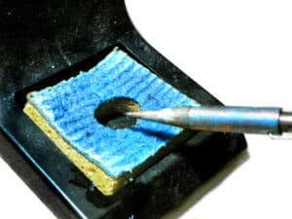
HardWare Components
Soldering Kit
It consists of the following components :
Soldering Stand
Wire Cutter
Wet Sponge
Safe place to put the hot soldering iron
Very handy little tool
used to cut wires
Inexpensive way of cleaning
the tip of soldering iron.

Slide 14


Arduino IDE
Autodesk TinkerCAD
Softwares
Libraries used :
<LiquidCrystal.h> -For LCD Display
<dht.h> -For DHT22 Temp & Humidity Sensor

Slide 15
WORK PLAN
Circuit Schematic Week-0
Purchasing of Components (excluding Humidifier Setup) Week-1
Assembling of Circuit Week-1&2
Delivery of Humidity Sensor Week-2
Delivery of Mist Maker Week-2
Purchasing of DIY Humidifier components Week-2
Program of the Setup Week-2&3
Making of DIY Humidifier Week-3
Project Completion Week-3

Slide 16
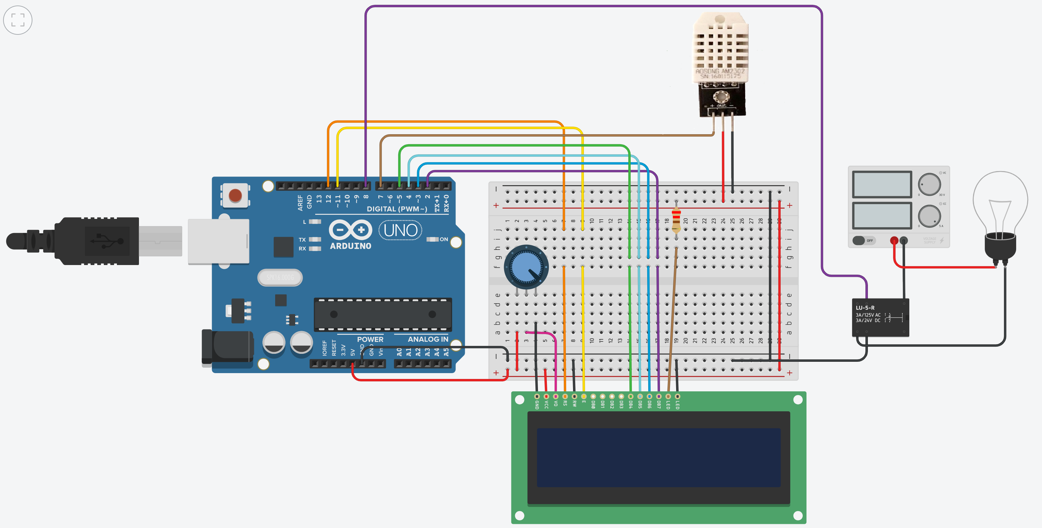
SCHEMATICS
*Here the Room Humidifier is replaced by the Light Bulb.

Slide 17
Work Done in details
For this project first we made a general list of the required components and then selected the desired components from the huge tray of components.
Then we moved on to the purchasing of the components by local shops and ordered the components which were not available locally.
Till the arrival of all the components, we started having discussions regarding the working of different components and also made schematic.
After arrival of the parts, we first made the Arduino circuit, set up the LCD Display and the DHT22 Humidity and Temperature Sensor and then did the programming.
Then we moved to the next phase of making of the DIY Humidifier using the fan and Mist-maker.
During the above two steps we were also solving the problems which were encountered by us.
After the completion of two discrete phases of the project, we merged them using a relay.
We now moved on to make the project aesthetically pleasing and our project was COMPLETE .

Slide 18
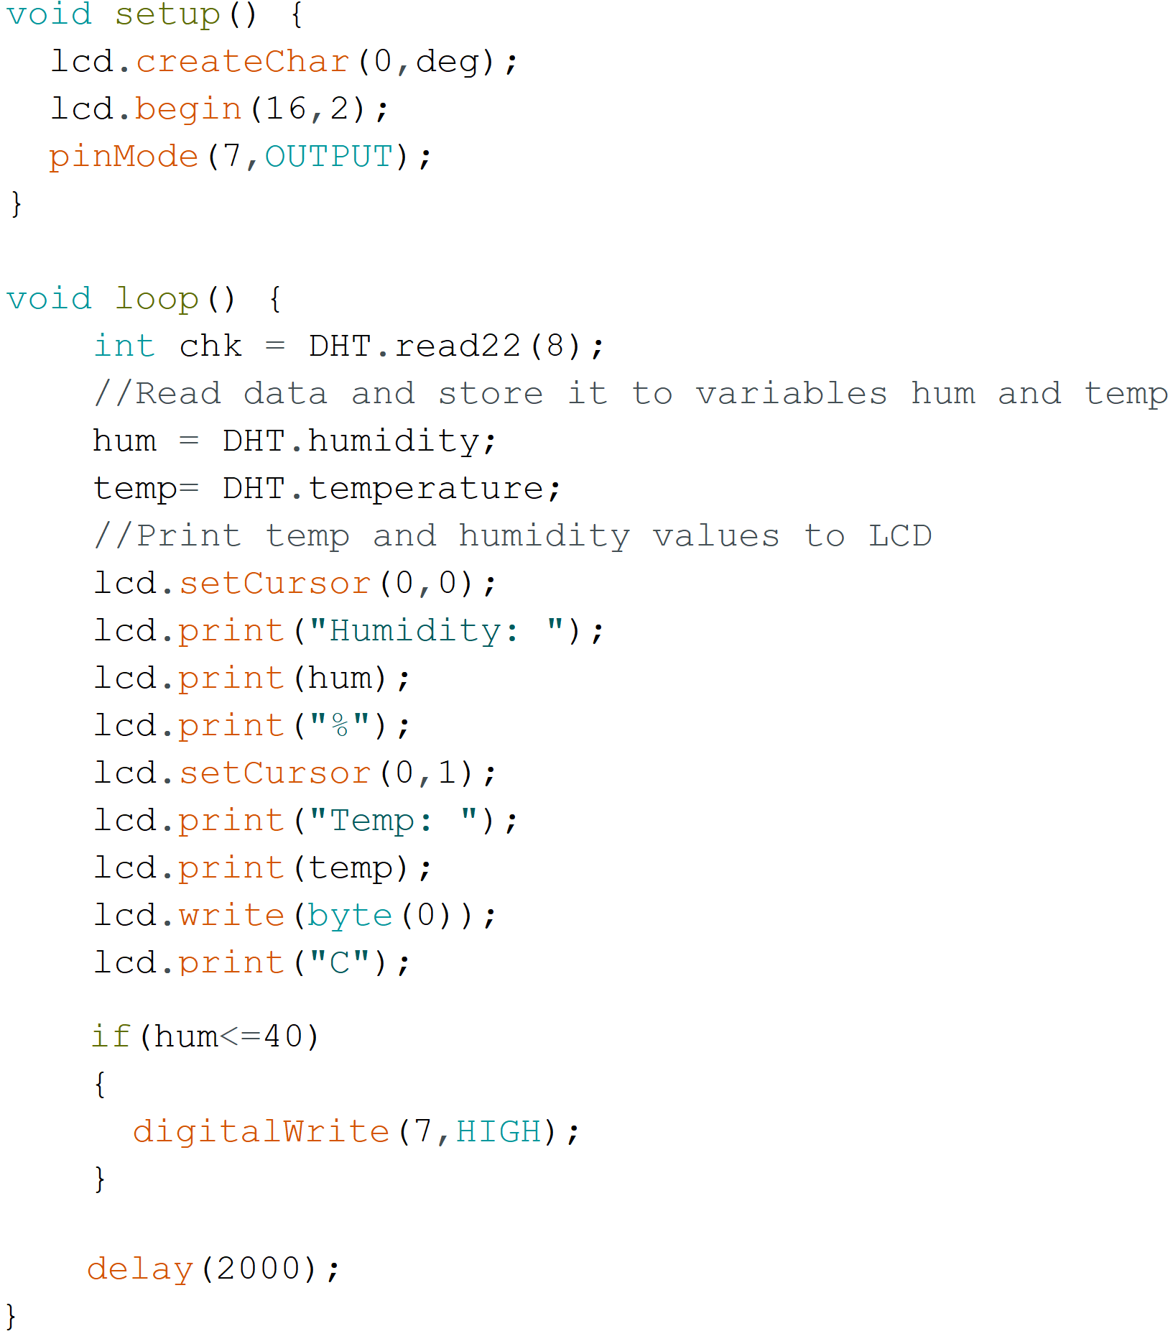
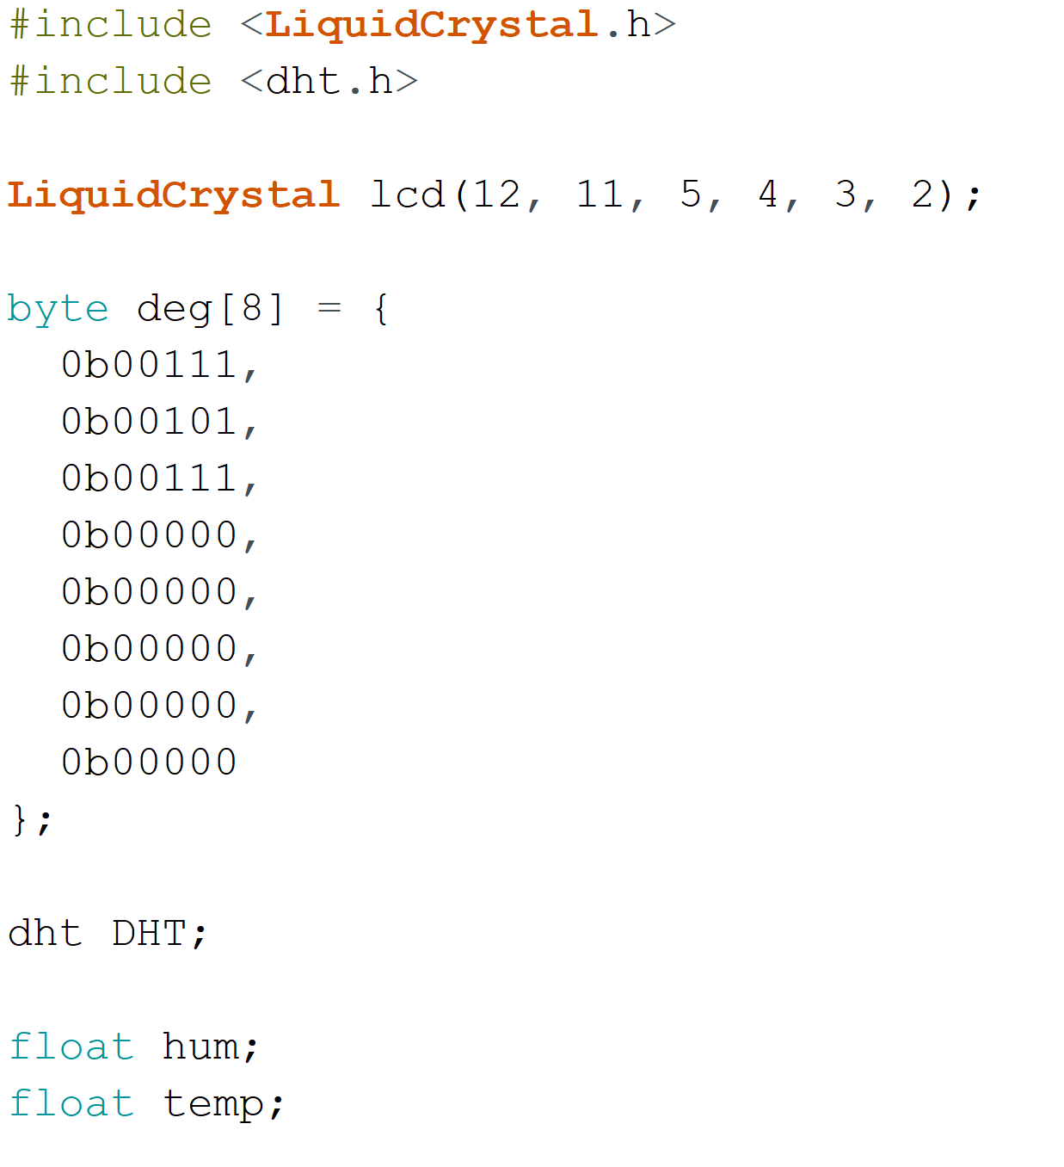
Program

Slide 19
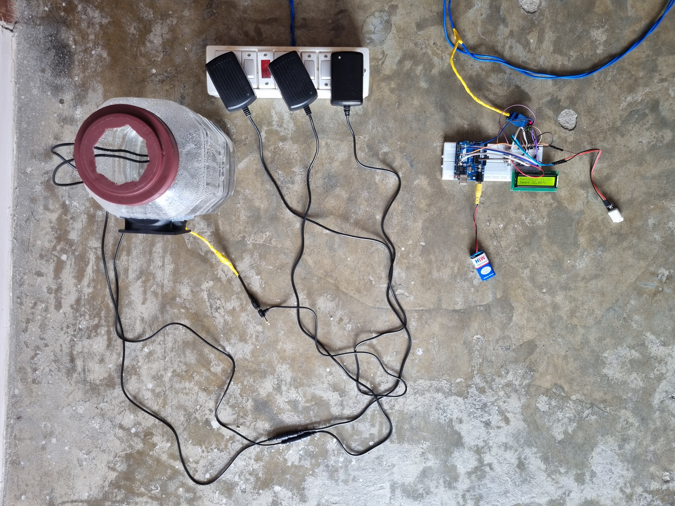
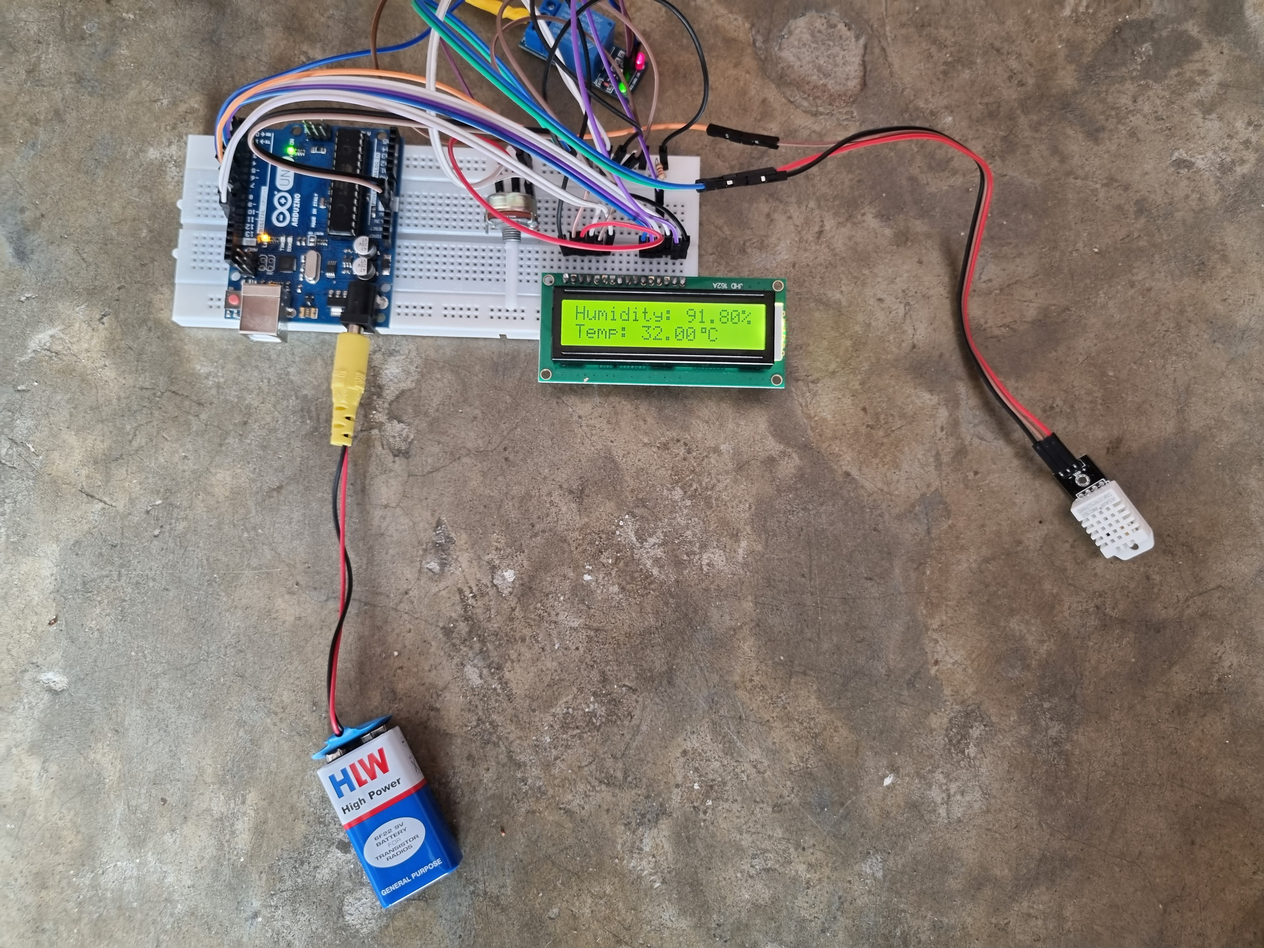
Stills of the project
Below, you can see that the humidity reading is ‘91.80%’. Hence in the image the humidifier is OFF.
In the right image, you can see reading of the humidifier closely.

Slide 20
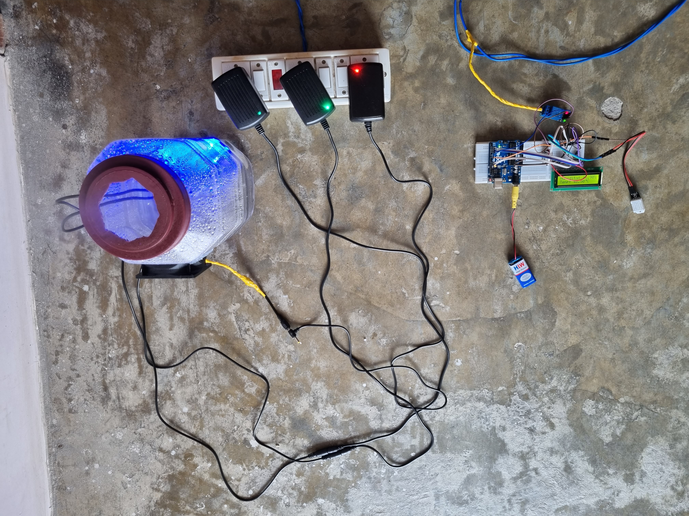
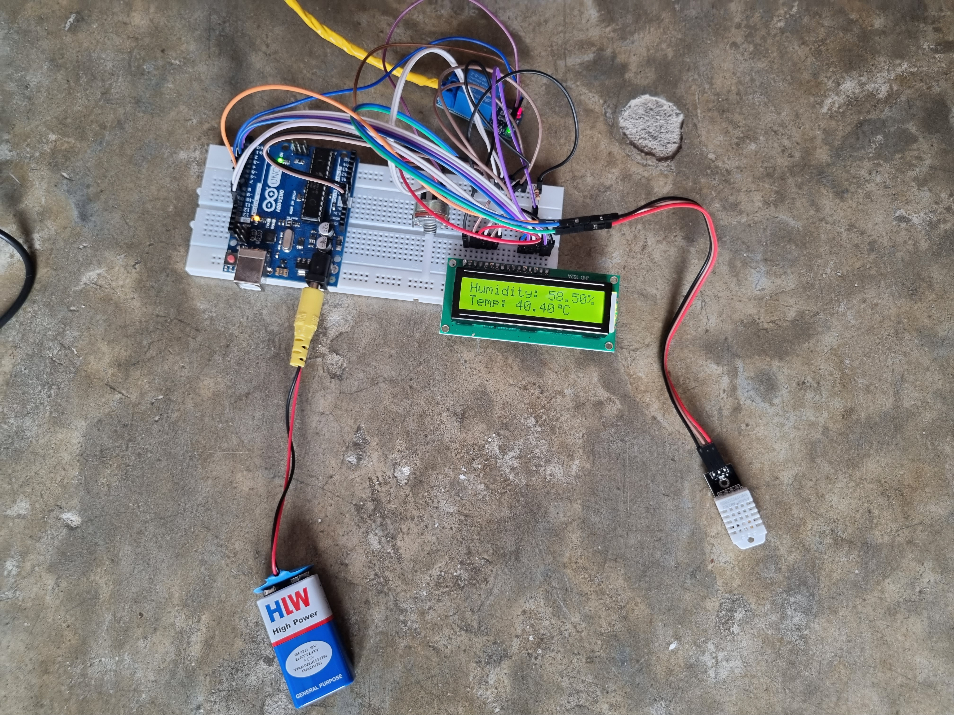
Stills of the project
Below, you can see that the humidity reading is ’58.50%’. Hence in the image the humidifier is ON.
In the right image, you can see reading of the humidifier closely.

Slide 21
References
DIY Humidifier - https://youtu.be/GzB21JOmbBM
Learning Soldering - https://youtu.be/6D5nylyWTK0
LCD Setup - https://youtu.be/Mr9FQKcrGpA
Custom Character generator for LCD - http://omerk.github.io/lcdchargen/
DHT22 Temp and Hum Sensor Setup and ‘<dht.h>’ library download - https://www.ardumotive.com/how-to-use-dht-22-sensor-en.html

Slide 22
WORK SHARING
—YASHRAJ SINGH
—NIKHIL SARASWAT
— SIRIPURAM BHANU TEJA
—GONUGUNTLA SWATHI
Assembling and Programming
Circuit Design and Programming
(20CS10079)
(20CS10039)
Background & Research Work
Background & Research Work
(20CS10059)
(20CS30020)

Slide 23
LINK TO
YOUTUBE video
https://youtu.be/KEvwqEnCCts

Slide 24


